Slide 1
Understanding Local Area Networking
Lesson 1

Slide 2
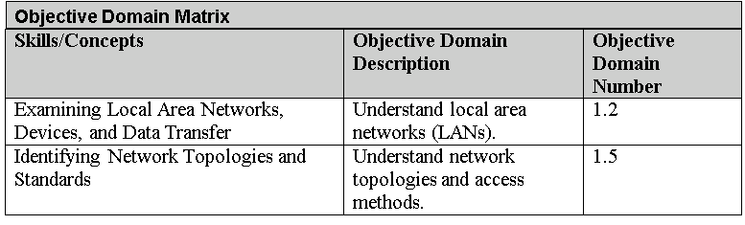
Objectives
Notes:
This should also be a review for the 70-642.

Slide 3
Local Area Network
A local area network (LAN) is a group of these computers that are confined to a small geographic area, usually one building.
LAN requires computers with network adapters, central connecting devices, and some type of medium to tie it all together, be it cabled or wireless connections

Slide 4
Networks are used to exchange data.
Real reasons for networks include:
Sharing
Communication
Organization
Money

Slide 5
Network Documentation
In order to understand LANs better, it helps to write out the structure of a LAN—in other words, to document it.
Network documentation is any information that helps describe, define, and otherwise explain how computers are connected in a physical and logical way.
The documentation phase occurs before a network is built, as well as whenever changes or additions are made to the network.
Microsoft Visio is a common tool used for network documentation,

Slide 6
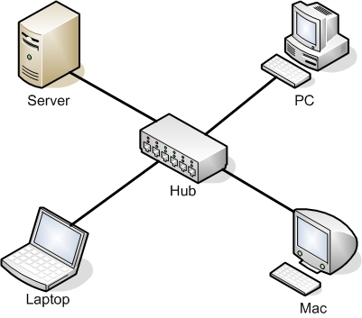
Hub
A hub is the most basic of central connecting devices.
It connects each of the networked computers, known as hosts, to one another by way of copper-based cables.
Any host that sends data must first send that data to the hub, where it is amplified and broadcast to the rest of the network.

Slide 7
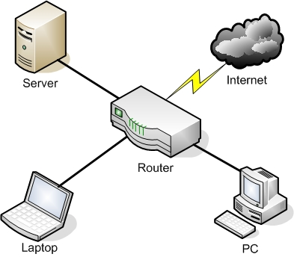
4-port Router
The router acts as a central connecting device, but it also has a special communications link to the Internet, thereby allowing the hosts to send data to and receive data from computers on the Internet.
This communications link between the router and the Internet is where the LAN ends.

Slide 8
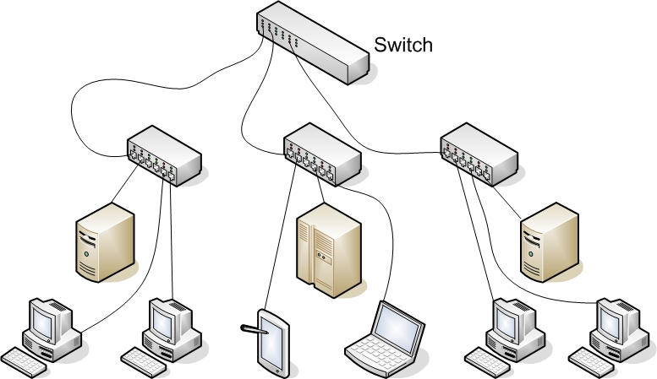
Switch

Slide 9
Network Adapter and RJ45 Patch Cable
A network adapter, also known as a network interface card or NIC, is the device that enables you to send and receive data to and from your computer.
An adapter can connect to the network by cable (wired) or by air (wireless).
RJ45 port (or an 8P8C) is the most common type of network adapter port, allowing the adapter to connect to most of today’s wired networks.
Notes:
This adapter might be integrated into the motherboard or act as a separate device that connects to a PCI slot or perhaps a PC card slot or USB port.

Slide 10
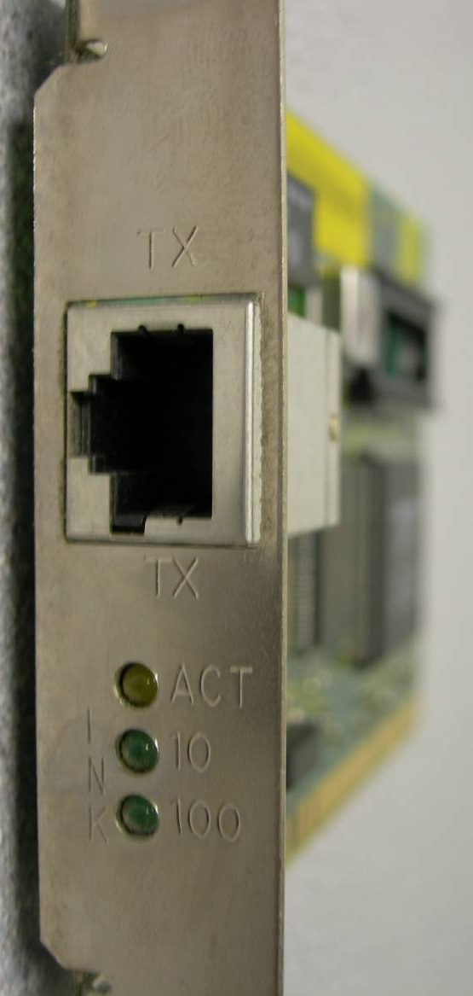
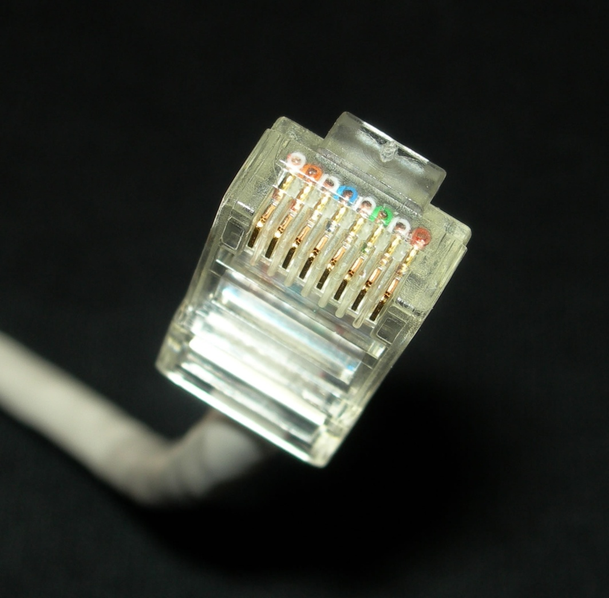
Network Adapter and RJ45 Patch Cable

Slide 11
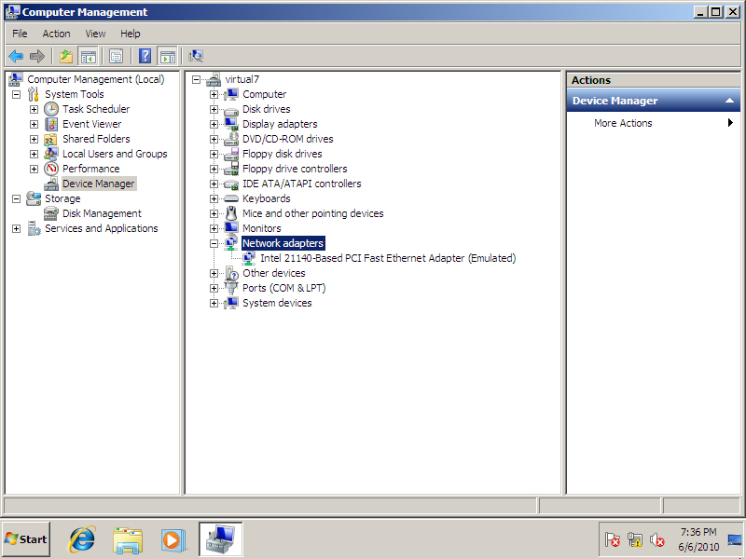
Device Manager Showing Network Adapters

Slide 12
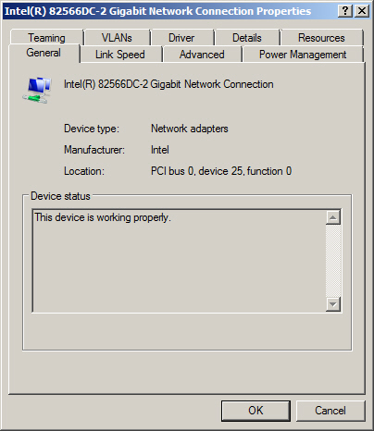
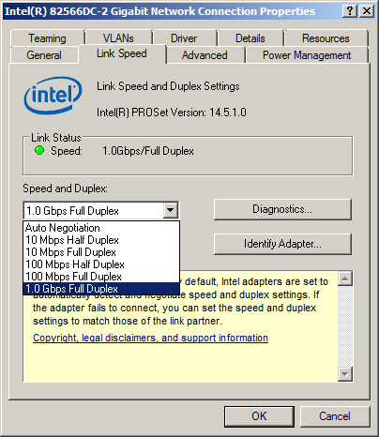
Intel Network Adapter Properties

Slide 13
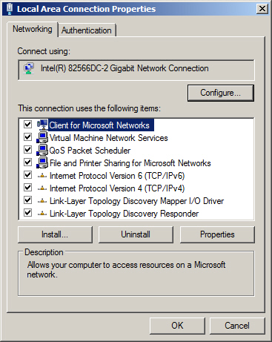
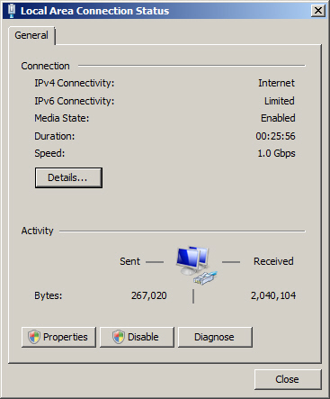
Intel Network Adapter Properties

Slide 14
Serial Data Transfer
Generally, when data is transferred on a LAN, it is sent in a serial fashion over twisted-pair cabling.
Serial data transfer means the transfer of one bit at a time—in other words, transfer in a single-bit stream.

Slide 15
Ethernet
Ethernet is a set of rules that govern the transmission of data between network adapters and various central connecting devices.
All network adapters and central connecting devices must be compatible with Ethernet in order to communicate with each other.
Common types of Ethernet include:
802.3u or Fast Ethernet that runs at 100 Mbps.
802.3ab or Gigabit Ethernet.

Slide 16
Types of Transfers
Broadcast has data sent to every other host on the network.
Unicast has data sent to one host only.

Slide 17
Data Transfer Rate
Data transfer rate, otherwise known as bit rate defines the maximum bits per second (bps) that can be transmitted over a network.
As mentioned, this value is rated in bits, and it is signified with a lowercase b (for example, 10 Mbps).
The lowercase b helps differentiate this amount from data that is stored on a hard drive, which uses an upper case B that stands for bytes (for example 10 MB).

Slide 18
IP Address
Today, every computer and many other devices have such an address.
An IP address allows each computer to send and receive information back and forth in an orderly and efficient manner.
An IP address identifies your computer number and the network it lives on.
A typical example of an IPv4 address would be 192.168.1.1.

Slide 19
IP Address
Every IP address is broken down into two parts: the network portion (in this case 192.168.1), which is the network that your computer is a member of, and the host portion, which is the individual number of your computer that differentiates your computer from any others on the network.
In this case, the host portion is.1.

Slide 20
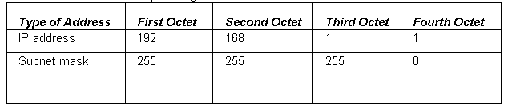
Subnet Mask
The subnet mask is a group of four numbers that define what IP network the computer is a member of.
All of the 255s in a subnet mask collectively refer to the network portion, whereas the 0s refer to the host portion.

Slide 21
Host
IP addresses are usually applied to your network adapter, but they can also be applied to other devices like switches, routers, and so on.
The fact that a device or computer has an IP address is what makes it a host.

Slide 22
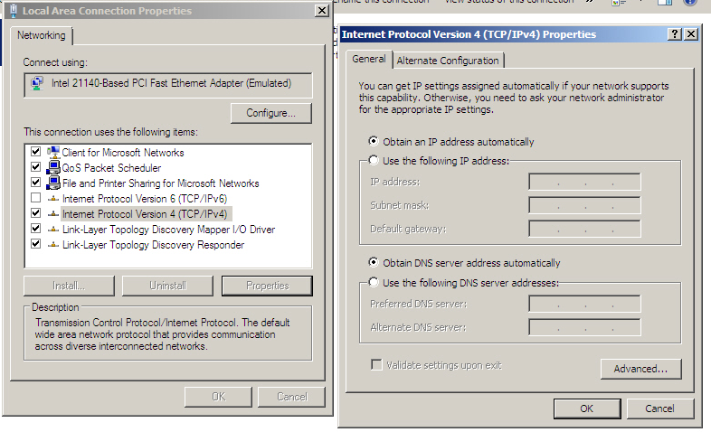
IP Address

Slide 23
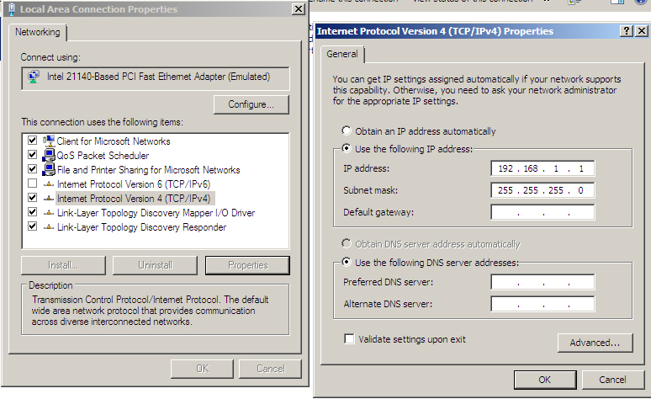
IP Address

Slide 24
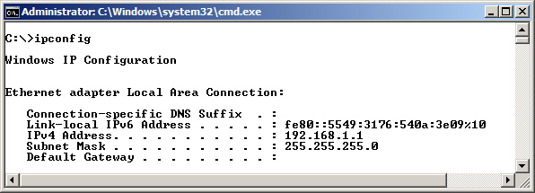
IPConfig Command
IPConfig command shows IP configuration information.

Slide 25
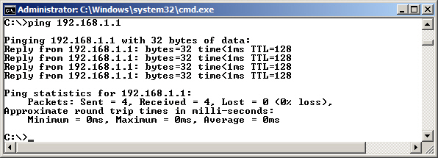
Ping Command
Ping command is used to test network connectivity between two hosts.

Slide 26
Ping Command
ping loopback
ping localhost
ping 127.0.0.1

Slide 27
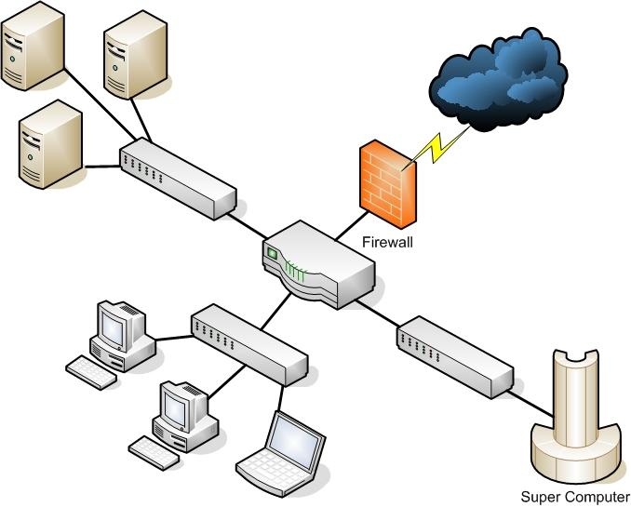
Wired LAN
Computers and other devices are wired using copper-based twisted-pair cables.

Slide 28
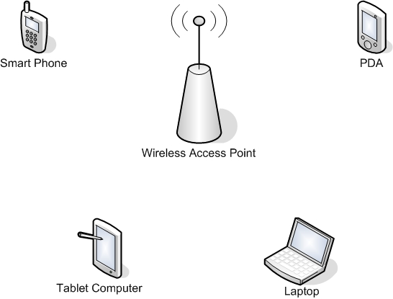
Wireless Local Area Network (WLAN)
A wireless local area network (WLAN) has many advantages, the most obvious of which is the ability to roam.

Slide 29
Wireless Access Point
The wireless access point (WAP) acts as the central connecting device for the network.
Today, such networks can consist of many types of devices other than traditional PCs, including smart phones, PDAs, tablet computers, and micro computers.
Not to mention the fact that PCs and laptops equipped with wireless network adapters can connect to these networks as well.

Slide 30
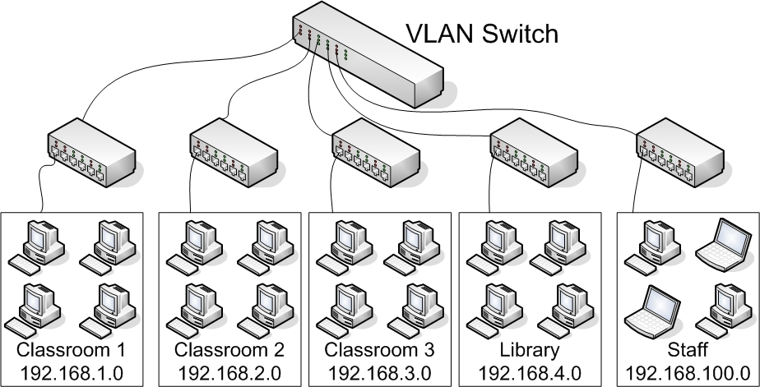
Virtual LAN
A virtual LAN is a group of hosts with a common set of requirements that communicate as if they were connected together in a normal fashion on one switch, regardless of their physical location.

Slide 31
Perimeter network
A perimeter network (also known as a demilitarized zone or DMZ) is a small network that is set up separately from a company’s private LAN and the Internet.
It is called a perimeter network because it is usually on the edge of the LAN, but DMZ has become a much more popular term

Slide 32
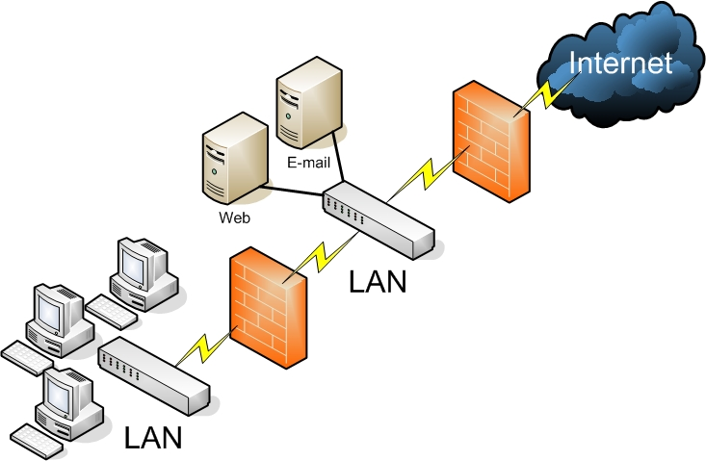
Back-to-Back Configuration

Slide 33
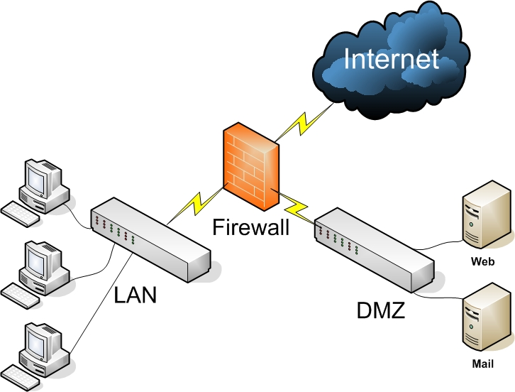
3-Leg Perimeter Configuration

Slide 34
Network Topology
A network topology defines the physical connections of hosts in a computer network.
There are several types of physical topologies including:
Bus
Ring
Star
Mesh
Tree

Slide 35
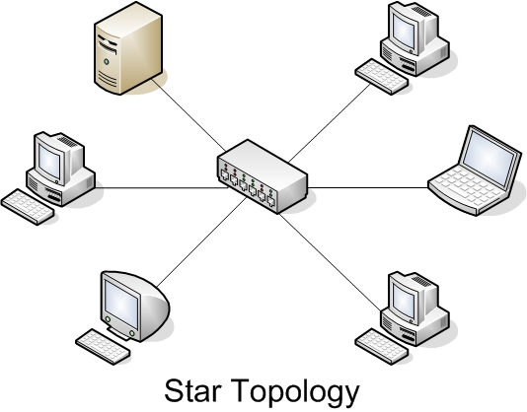
Star Topology
Most Common topology
Each computer is individually wired to a central connecting device (hub, switch or SOHO router) with twisted-pair cabling.

Slide 36
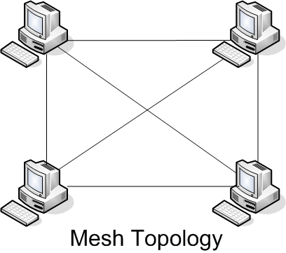
Mesh Topology
Every computer connects to every other computer; no central connecting device is needed.

Slide 37
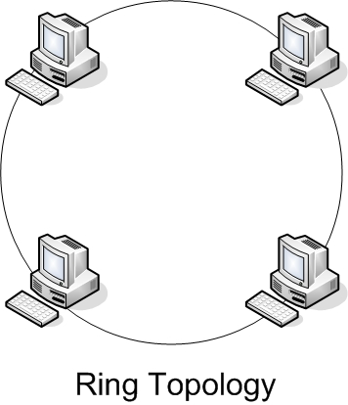
Ring Topology
In a LAN environment, each computer is connected to the network using a closed loop.
Used by Token Ring and FDDI.

Slide 38
Token Ring
A Token Ring network sends data logically in a ring fashion, meaning that a token goes to each computer, one at a time, and continues on in cycles.
However, Token Ring computers are physically connected in a star fashion.
Namely, all computers in a Token Ring network are connected to a central connecting device known as a Multistation Access Unit (MAU or MSAU).

Slide 39
Ethernet
Ethernet is a group of networking technologies that define how information is sent and received between network adapters, hubs, switches, and other devices.
Ethernet is the de facto standard and has the largest share of networks in place today.
Ethernet is standardized by the Institute of Electrical and Electronics Engineers (IEEE) as 802.3.

Slide 40
Frames
Computers on Ethernet networks communicate by sending Ethernet frames.
A frame is a group of bytes packaged by a network adapter for transmission across the network
These frames are created and reside on Layer 2 of the OSI model
By default, computers on Ethernet networks all share a single channel. Because of this, only one computer can transmit at a time.
However, newer networks with more advanced switches transcend this limitation.

Slide 41
IEEE 802.3
IEEE 802.3 defines carrier sense multiple access with collision detection or CSMA/CD.
Because computers on a default Ethernet LAN all share the same channel, CSMA/CD governs the way that computers co-exist with limited collisions.
If an organization utilizes wireless Ethernet, carrier sense multiple access with collision avoidance (CSMA/CA) is employed.

Slide 42
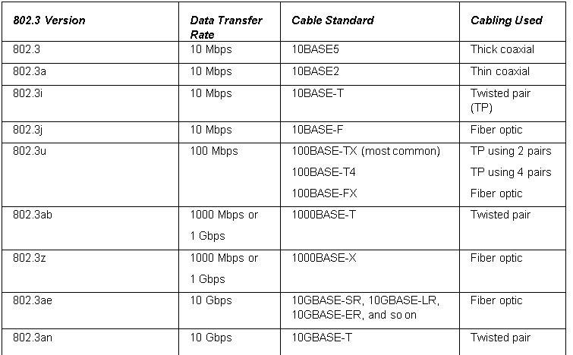
802.3 Ethernet Standards
multiple access with collision avoidance (CSMA/CA)

Slide 43
Centralized Computing
The older type of computing was known as centralized computing.
This was the case during the days of the mainframe, in which there was one super computer and the rest of the devices that connected to the super computer were known as terminals (or dumb terminals).
Each terminal consisted solely of a keyboard and display with no processing power.

Slide 44
Distributive Computing
Today’s computing is known as distributive computing and is used for both client-server and peer-to-peer networks.
This means that every device or workstation has its own processing power.

Slide 45
Terminal Services and Remote Sessions
However, in a way, the idea of centralized computing has made a comeback of sorts. Terminal services and remote sessions to computers are based off of the centralized computing model.
Thin-client computers do not have a hard drive and store an operating system in RAM, to be loaded up every time the device is turned on.
All other applications and data are stored centrally. So, in a way, this system is a blend of some centralized computing with some distributive computing.

Slide 46
Client Server Model
The client-server model is an architecture that distributes applications between servers such as Windows Server 2008 and client computers such as Windows 7 or Windows Vista machines.

Slide 47
Servers
Computers that provide services:
File server
Print server
Database server
Network controller
Messaging server
Web server
CTI-based server

Slide 48
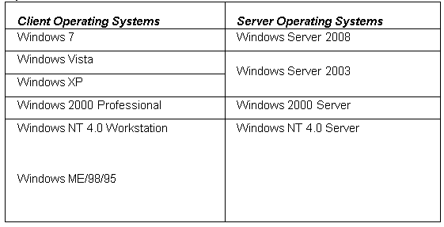
Client and Server Operating Systems

Slide 49
Peer-to-Peer Networking
Peer-to-peer networking first and foremost means that each computer is treated as an equal.
Today, peer computers can serve data; the only difference is that they can only serve it to a small number of computers at the same time.

Slide 50
P2P
Peer-to-peer has taken on a second meaning over the past decade or so.
Now it refers to file sharing networks, and in this case is referred to as P2P.
Examples of file sharing networks include Napster, Gnutella, and G2, but other technologies also take advantage of P2P file sharing, such as Skype, VoIP, and cloud computing.

Slide 51
Summary
To understand local area networks (LANs), including but not limited to LAN elements, design, perimeter networks, IP addressing, and LAN types.
To understand network topologies and access methods, including topologies such as star, mesh, and ring; Ethernet architecture; and the client-server and peer-to-peer networking models.

